Slide 1

TECH 1004 & TECH 1004 UAC AI Technologies
Covolutional Neural Network
By Hu Wang

Slide 2
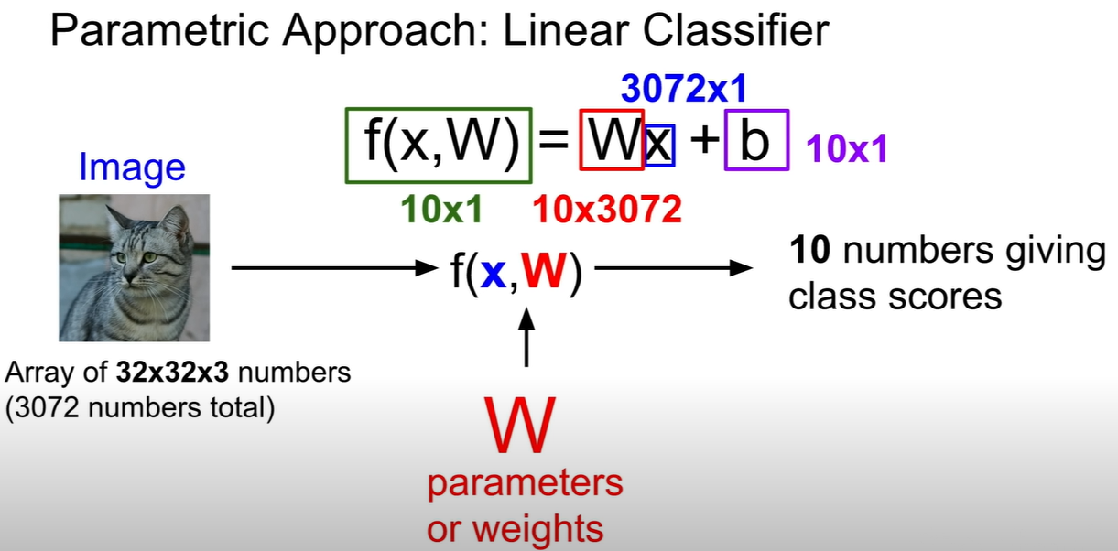
cs231n_2019_lecture02.pdf

Slide 3
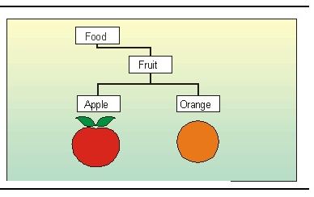
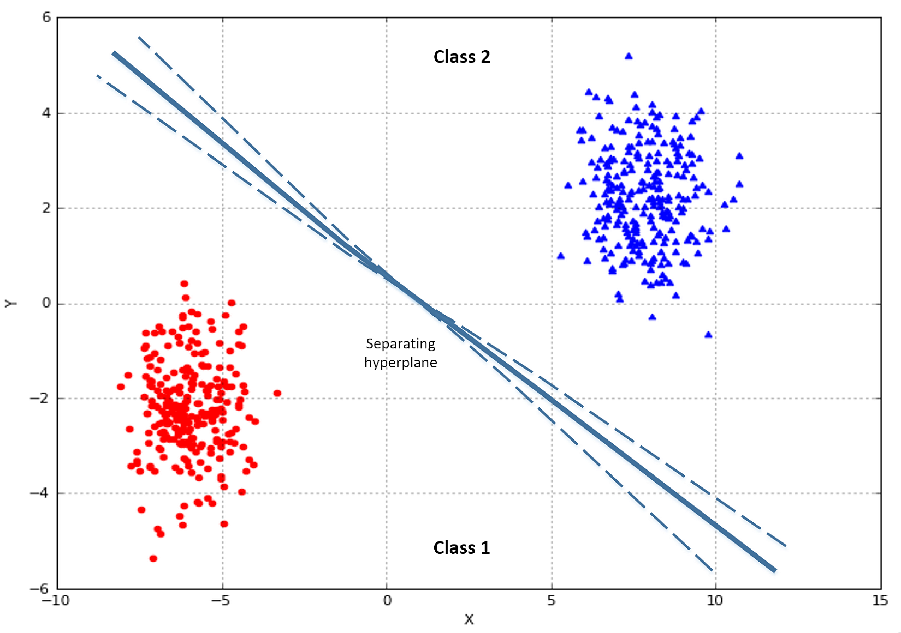
Classification --- An example

Slide 4
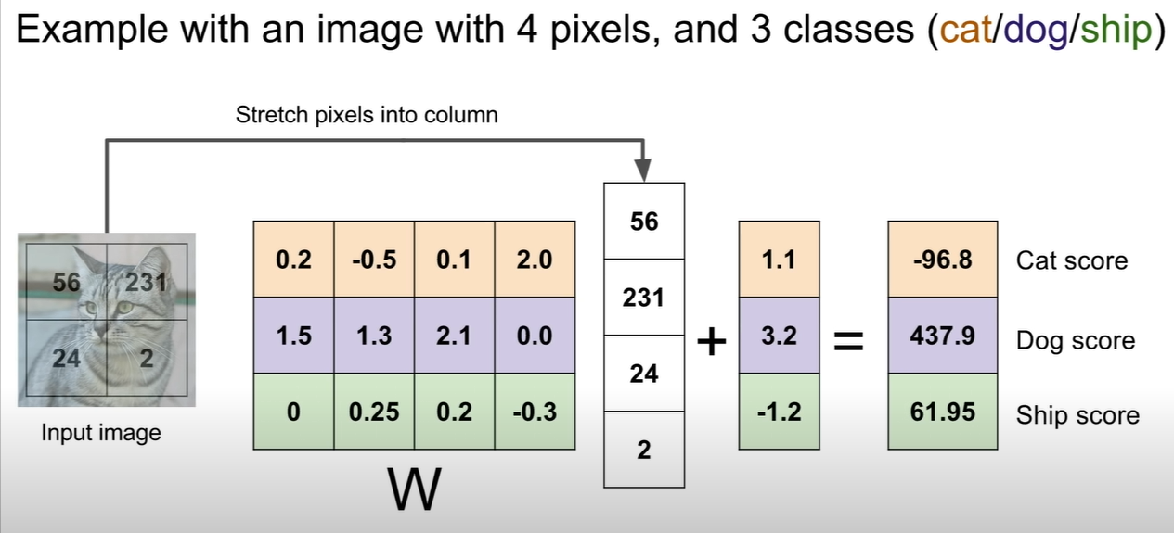
cs231n_2019_lecture02.pdf

Slide 5
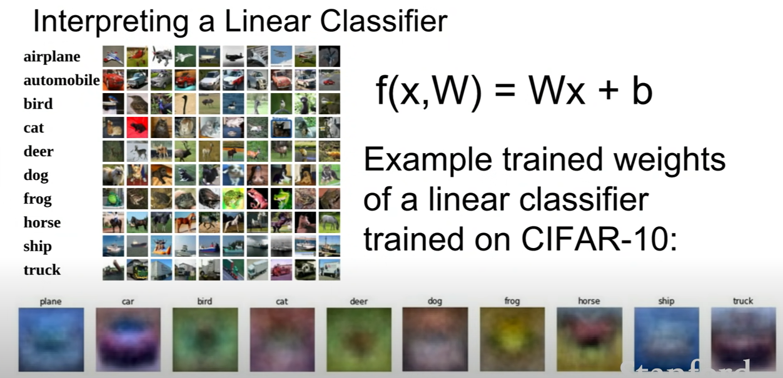
cs231n_2019_lecture02.pdf

Slide 6
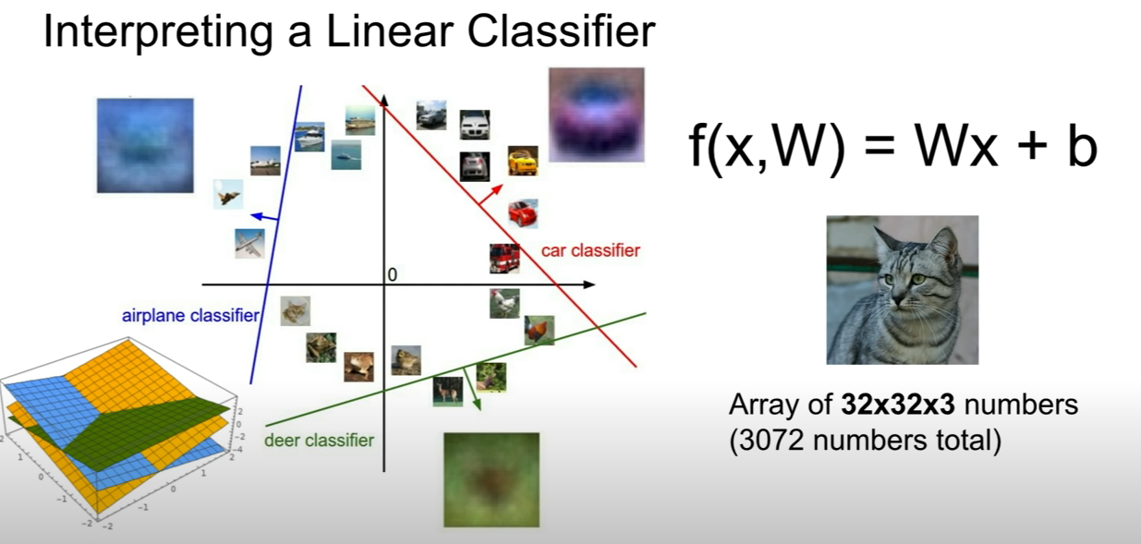
cs231n_2019_lecture02.pdf

Slide 7
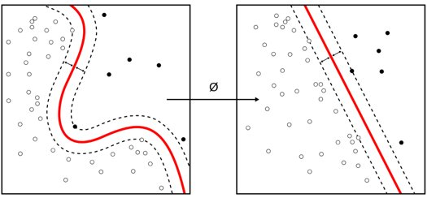

Classification --- Non-linear

Slide 8
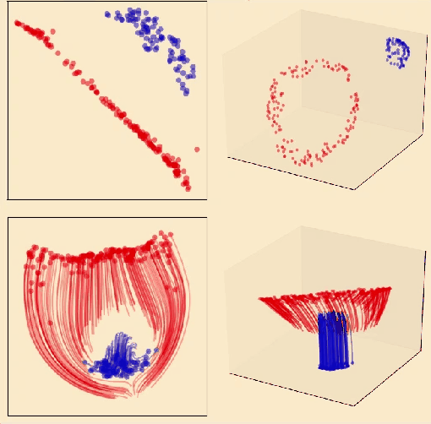
Classification --- Non-linear

Slide 9
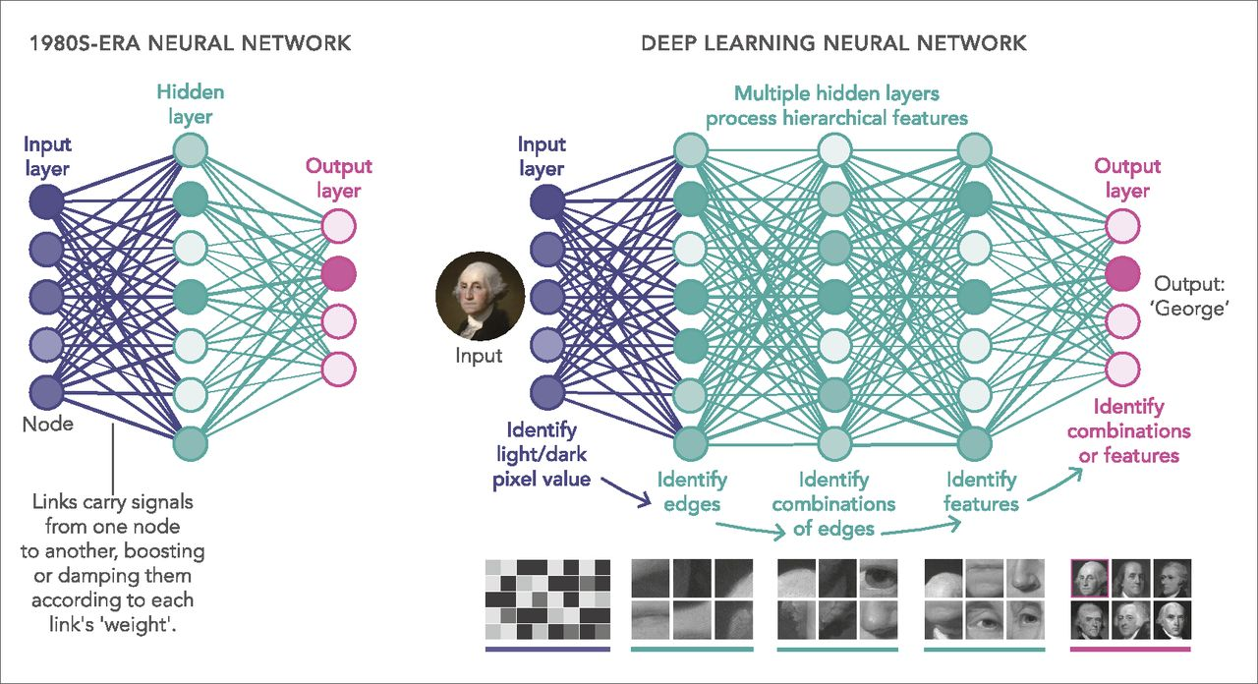
Neural Networks & Deep Learning

Slide 10
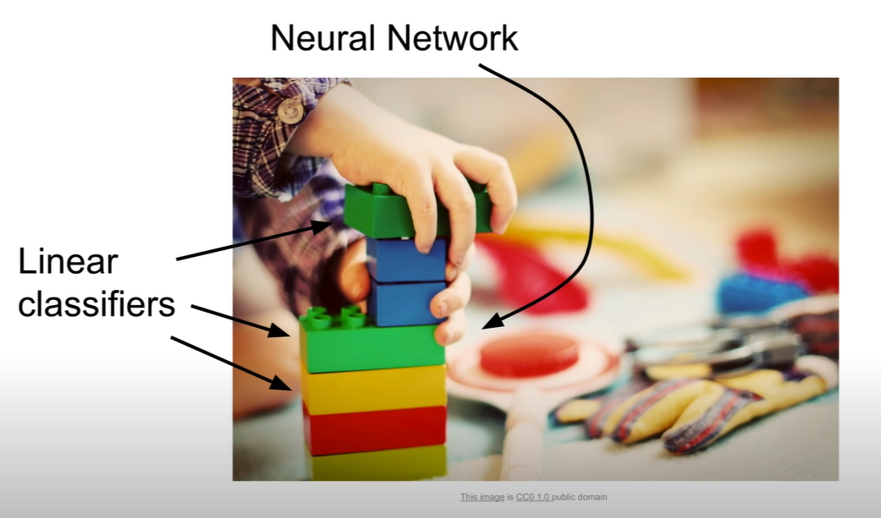
cs231n_2019_lecture02.pdf

Slide 11
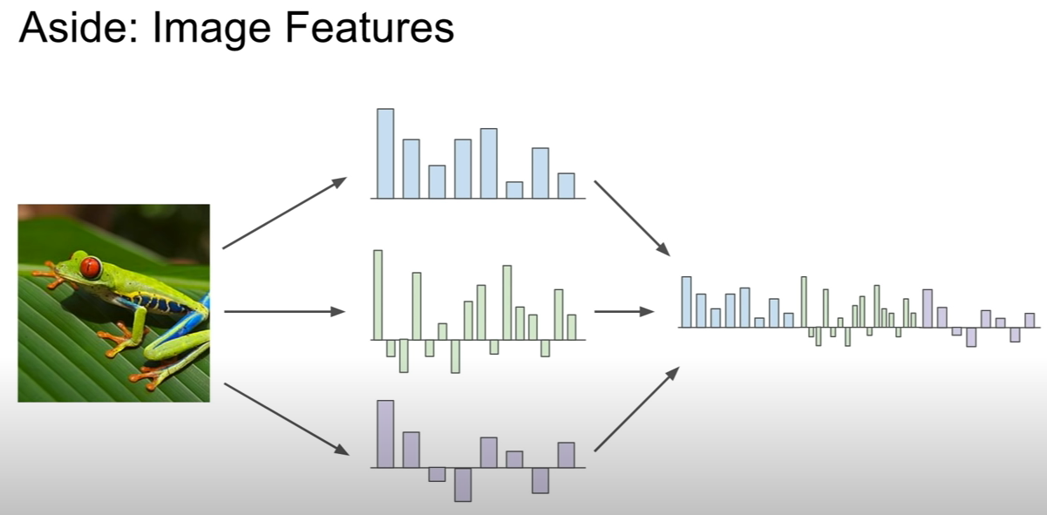
cs231n_2019_lecture02.pdf

Slide 12
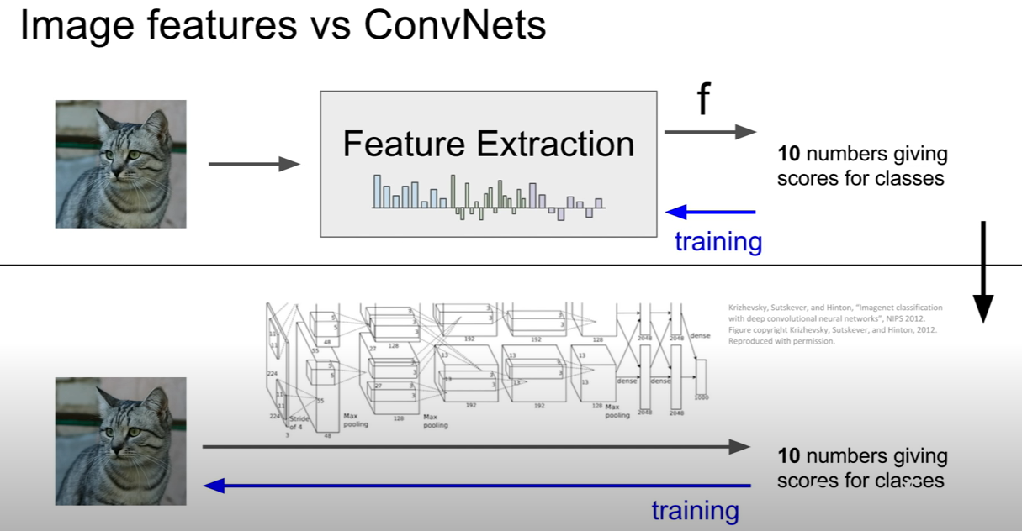
cs231n_2019_lecture02.pdf

Slide 13
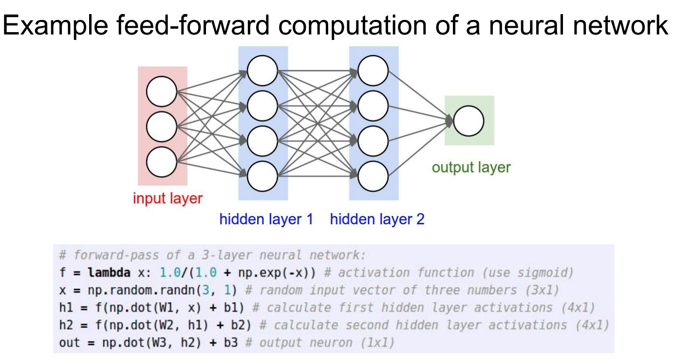
cs231n_2019_lecture02.pdf

Slide 14
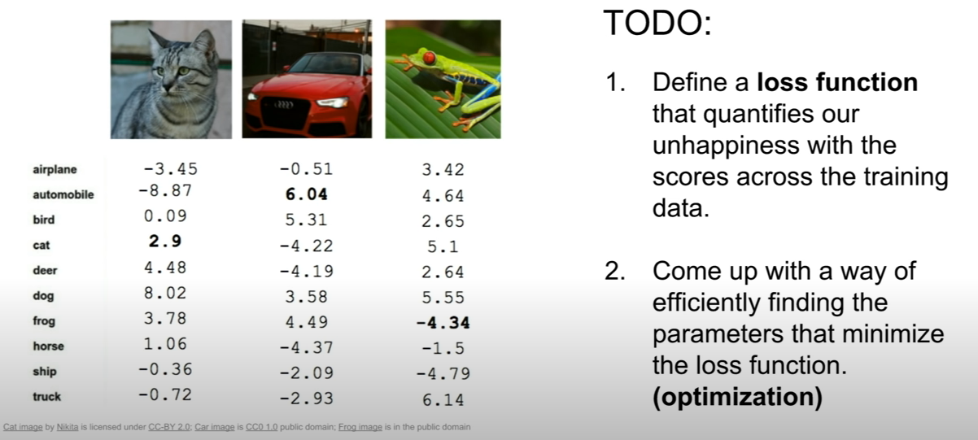
TODO List
cs231n_2019_lecture02.pdf

Slide 15
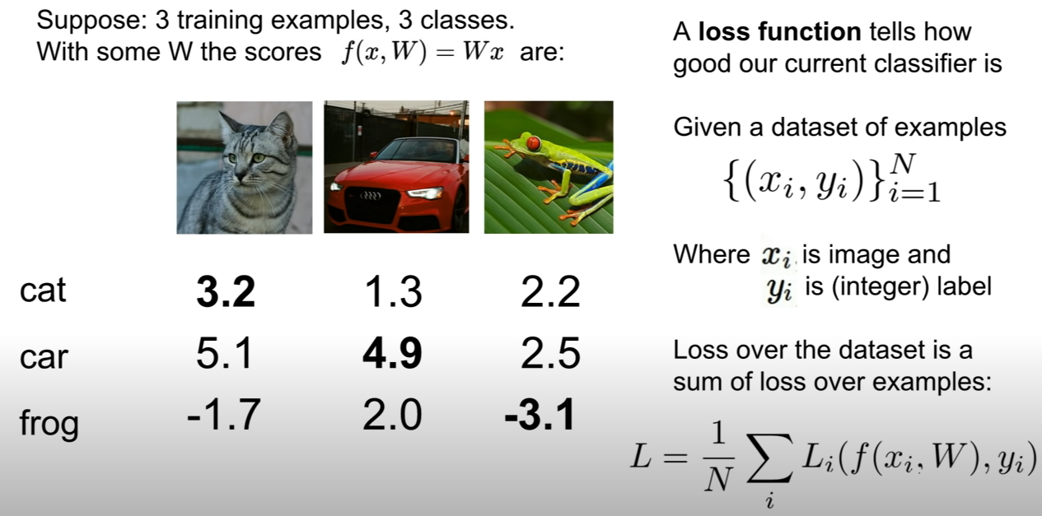
Loss function is to judge how good your model perform
cs231n_2019_lecture02.pdf

Slide 16
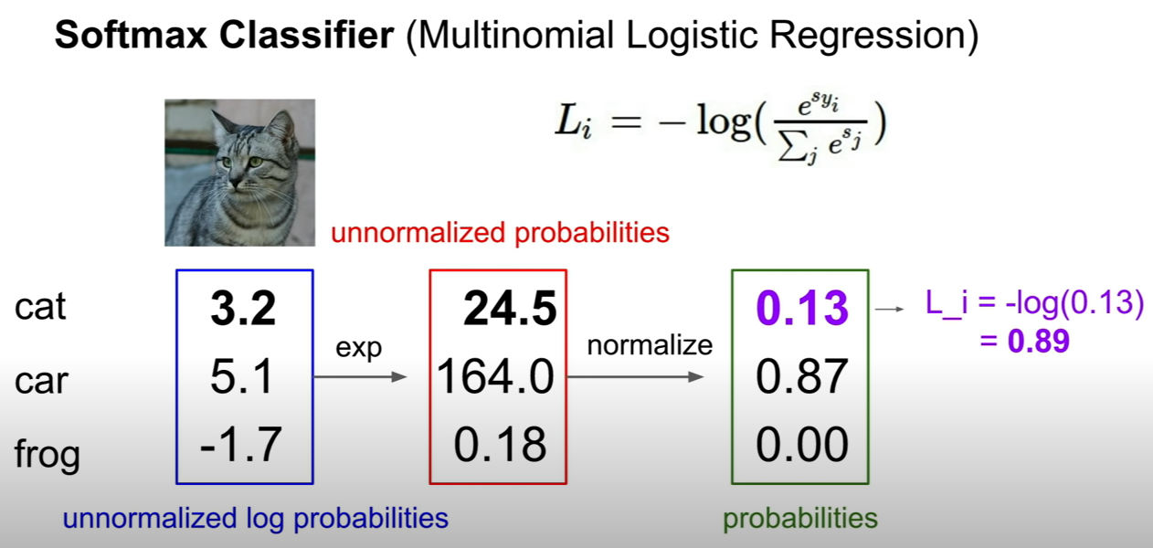
cs231n_2019_lecture02.pdf

Slide 17
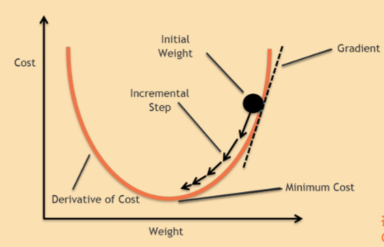
Gradient Descent

Slide 18
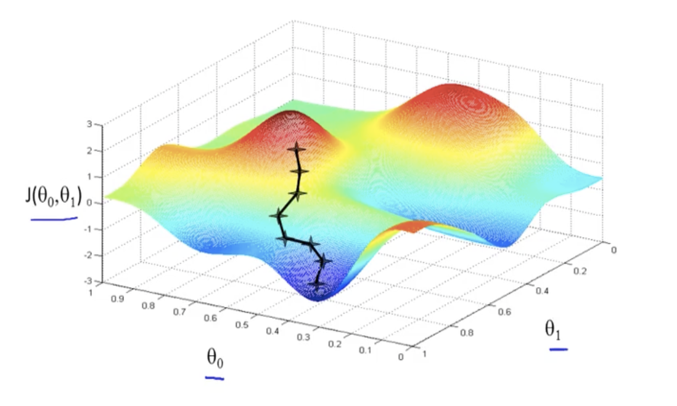
Gradient Descent

Slide 19

Gradient Descent

Slide 20
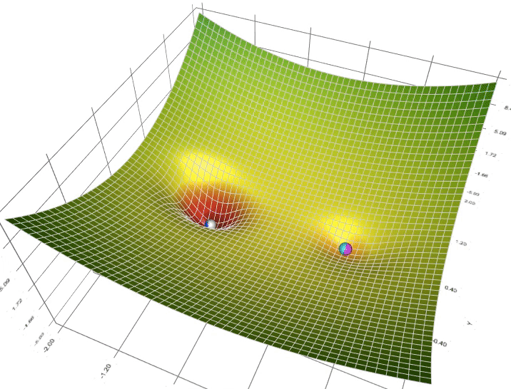

Slide 21
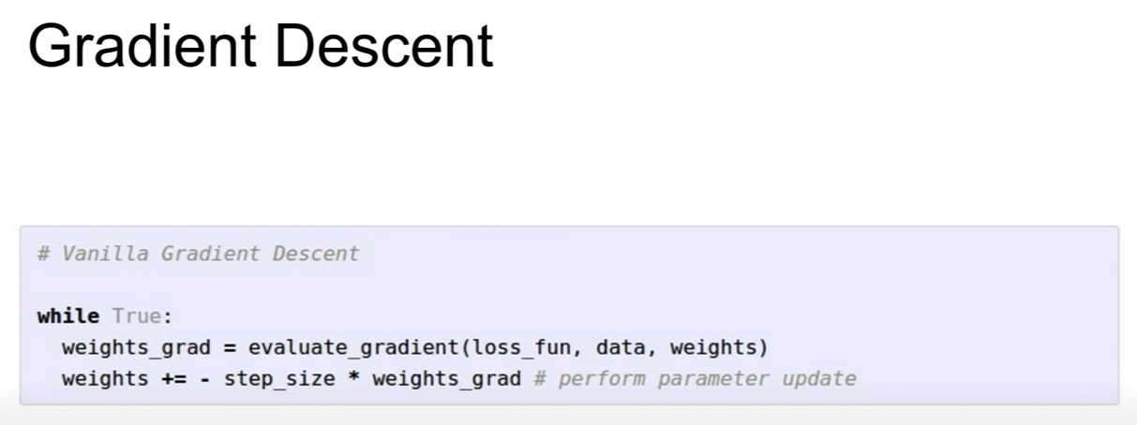
cs231n_2019_lecture02.pdf

Slide 22
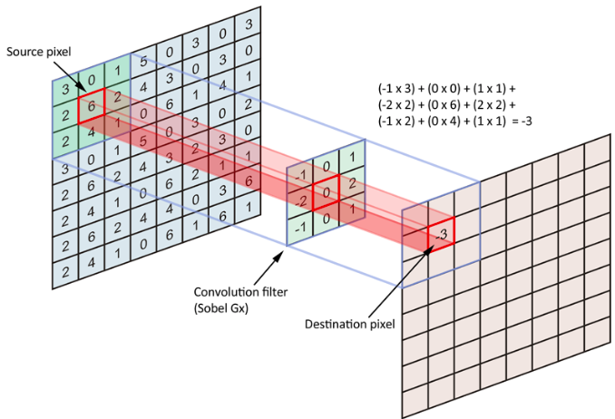
CNN

Slide 23

CNNs

Slide 24
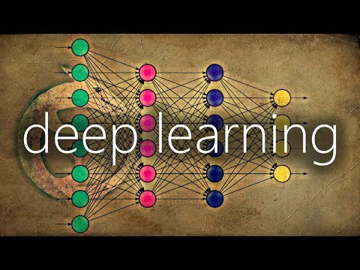
Convolutional Neural Network
https://www.youtube.com/watch?v=YRhxdVk_sIs

Slide 25
Demo
https://poloclub.github.io/cnn-explainer/

Slide 26
Reference
Cs231n Stanford University Tutorial
http://cs231n.stanford.edu/
https://www.youtube.com/watch?v=vT1JzLTH4G4

